Slide 1



ROBOTICS!
Mr Butler’s Robotics Lesson

Slide 2



WHAT YOU NEED TO KNOW
Describe the technology involved in the use of robotics
Evaluate the use of robotics in a range of commercial situations

Slide 3

What actually is a Robot?
What defines Robotics?
A robot is a computer-controlled mechanical device that is sufficiently flexible to be able to do a variety of tasks.
Robots are frequently used to do jobs where consistent performance is required
  such as paint spraying motor cars
or where there is some danger to humans performing the task
  such as the handling of toxic materials
Robotics, or cybernetics, have been defined as the use of information processing to organise and control systems of communicating individuals.
Robotics concerns the design, construction, operation and application of robots which are computer-controlled mechanical devices. It includes the study of computer control of processes.
It is the combination of a range of disciplines, including Computer Science and Mechanical Engineering, to support the incorporation of sensors and feedback in the creation of robots.

Slide 4

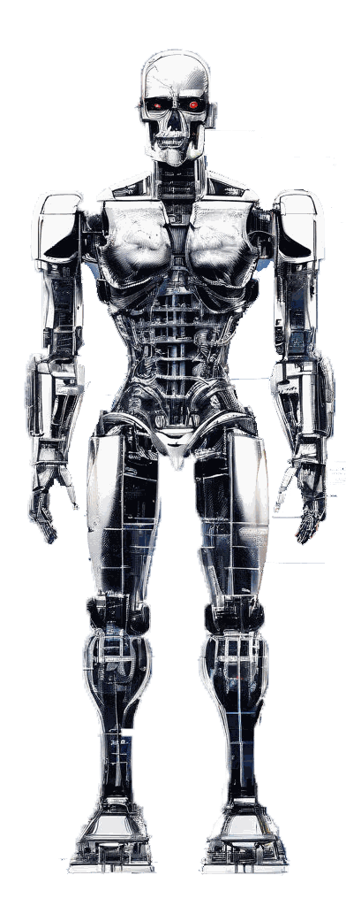
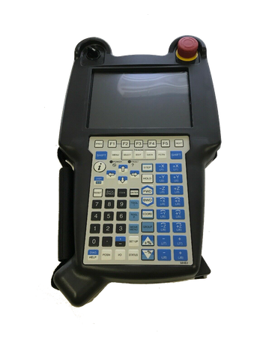
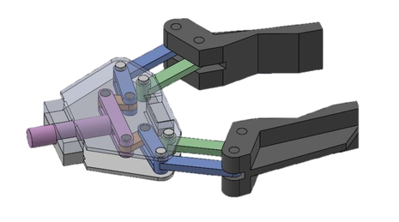
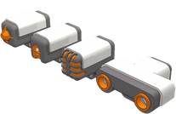
What Makes Up A Robot?
Controller
the ‘brain’ of the robot arm
coordinates the operation of all of the other parts.
It is controlled by a computer program, often input using a teach pendant
A Teach Pendant
A specially designed hand held device used to instruct the robot by specifying the movements it is expected to take in order to complete a given task.
Arm
Can vary in shape and size
Part of the robot that will position a device called the end effector.
Can move and rotate the end effector into place using a range of joints.
Each joint adds an additional 3 degrees of freedom (usually 6 degrees in most robots)
End Effector
An item of hardware which connects to the robot arm and performs a specific function.
Can be in the form of grippers, vacuum pumps, magnets, welding torches or paint sprays etc.
Can often be changed to support the completion of different tasks
Drive
The engine or motor used to move the various robot parts into an appropriate position. Drives may be hydraulic, electric or pneumatic.
Sensors
provide feedback to the controller about the environment
Will collect data regarding the environment, this is processed by the controller to help determine any further actions the robot arm needs to take to help complete the programmed task.
Notes:
Further Reading: https://www.learnaboutrobots.com/

Slide 5

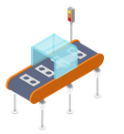




What Do We Use Robots for?
Robots can complete welding tasks to a standardised quality and at high speed, for example in the car industry.
robots were first used to aid with the assembly of products which required repetitive actions due to their fast speed of operation and ability to work continually.
robots are ideal for the packing and unpacking of large quantities onto pallets for storage or transportation due again to their high speed of operation, their ability to transport large quantities in one go
They also excel in their ability to complete complex tasks to a standardised quality (folding of magazines and insertion of additional leaflets / mini magazines etc.)
the use of robot arms to complete painting tasks means there is not wastage, standardised quality of work at a high speed. Often at a reduced cost.
This can be particularly useful in situations where fumes can prove hazardous to humans.
Welding
Spray Painting
Product Assembly
Product Packaging
robots are ideal for outer space exploration; scientists can collect the samples they require without putting themselves in danger.
robots are more currently being used to support surgery for example in remote areas, again with a high level of precision.
Benefits + Drawbacks
Aerospace Robots
They can operate in conditions dangerous for humans
They can perform repetitive tasks consistently and accurately
They can be re-programmed to perform new tasks
They are very expensive to design and produce
They cannot show initiative or respond intuitively to unexpected situations
Healthcare

Slide 6
Questions
Explain the term robotics [4]
Evaluate the use of robotics in a car assembly line [6]
Evaluate the use of robotics in exploring another planet. [6]
Robots are used to assist surgeons during some types of operation.
Describe two advantages of using robots in this case [4]
Describe two disadvantages of using robots in this case [4]
5. Robots are used by car manufacturers to spray paint cars.
Describe two benefits of using robots in this case. [4]

Slide 7
Explain the term robotics [4]
The combination of a range of disciplines
Computer Science/Mechanical engineering/Electrical engineering
To support the design, production and operation of robots
Incorporates sensors and feedback
Notes:
Recently CCEA have started directly quoting the fact files in their mark schemes.

Slide 8
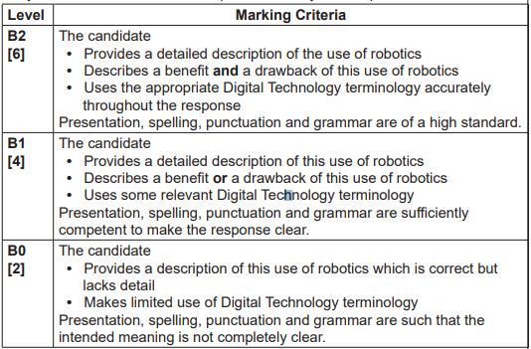
Evaluate the use of robotics in a car assembly line [6]
Robots can support or replace humans
They can fetch car parts and assemble cars on assembly lines
They can paint car parts
Evaluation
They can operate in conditions dangerous for humans
They can perform repetitive tasks consistently and accurately
They can be re-programmed to perform new tasks
They are very expensive to design and produce
They cannot show initiative or respond intuitively to unexpected situations

Slide 9
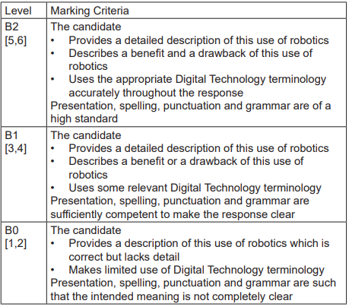
Evaluate the use of robotics in exploring another planet. [6]
Robots can support or replace humans
They can position measuring instruments, collect samples, assemble structures to protect humans
Autonomous rovers can move around the surface
Evaluation
They can operate in inhospitable conditions and withstand powerful launch and landing forces
The loss of a robot is preferable to that of an astronaut
They can perform repetitive tasks consistently and accurately
They can weigh very little and require little power
They do not require life support systems
They are expensive to design and produce
Radio signals from earth take a long time to reach a planet
Robots must be able to operate on their own but cannot show initiative or respond intuitively to unexpected situations

Slide 10


Robots are used to assist surgeons during some types of operation. Describe two advantages and two disadvantages of using robots in this case [8]
Improved quality of surgery
  … because robots work consistently
Leads to better productivity/more operations
  … because robots can work faster than humans/can be reprogrammed/ remote surgery is possible
Improved quality of surgery
  … because robots produce error free work/can work accurately
Using robotic surgery, surgeons can perform delicate and complex procedures
  … that may have been difficult or impossible with other methods
Robotic surgery makes minimally invasive surgery possible/tiny incisions
  … resulting in fewer complications, such as surgical site infection, less pain and blood loss
Surgical robots are costly to maintain
  … and their operation requires additional training
Reliance on the technology working/possibility of malfunction/unexpected events
  … which is critical during surgery
No tactile feedback
  … can cause complications

Slide 11
Robots are used by car manufacturers to spray paint cars. Describe two benefits of using robots in this case. [4]
NOTE The benefit is needed for the second point
Leads to improved quality … because robots work consistently
Leads to better productivity … because robots can work faster than humans/can be reprogrammed
Leads to improved quality … because robots produce error free work
Leads to improved safety … because robots can work in hazardous environments

